Slide 1

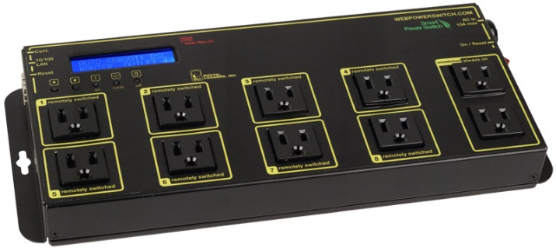

MeshCentral
{
"domains": {
"": {
"ipkvm": true
]
}
}

Slide 2


MeshCentral
Device Group Manager

Slide 3
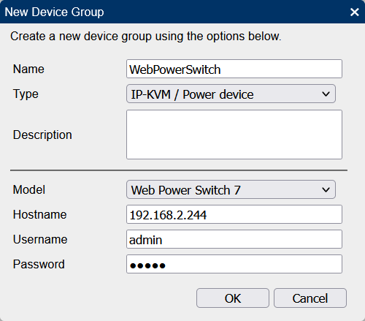
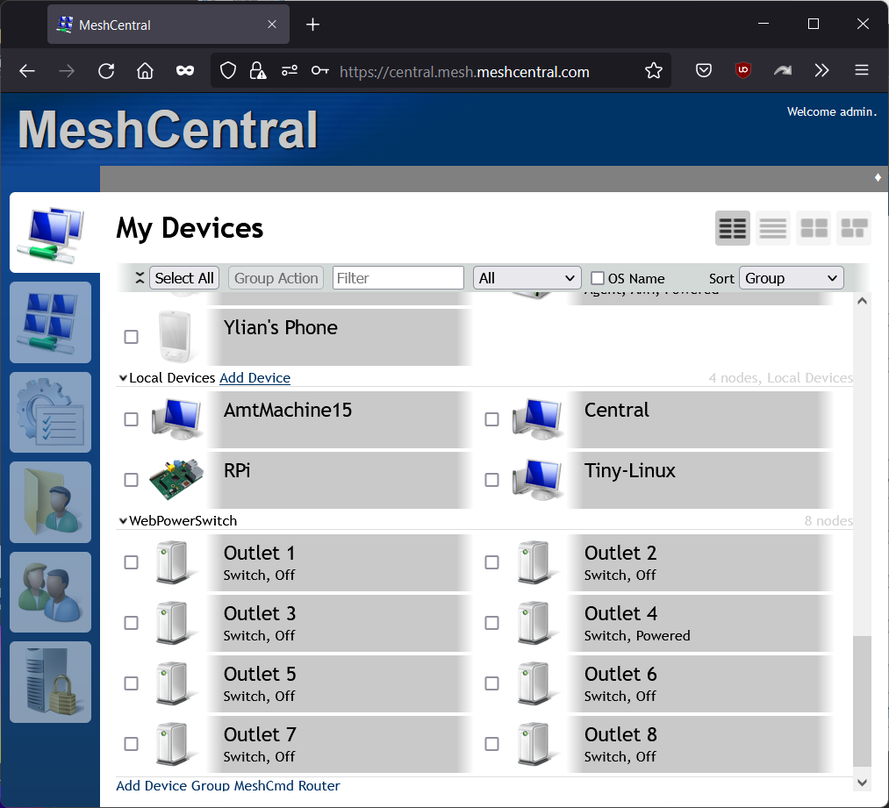
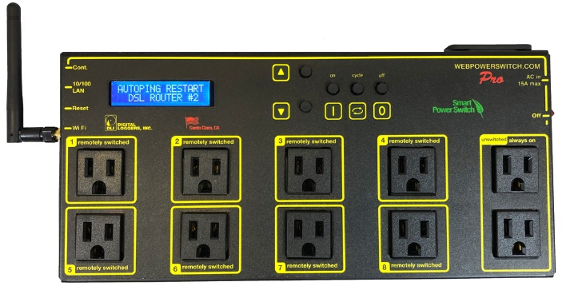

Slide 4
